Slide 1
PSEA: The VOICe for Education Support Professionals, Students and Public Education in PA
JOIN US and be heard.
JOIN US and be heard.
Notes:
Brief general intro slide, insert Comms awesome branding/tag line!
ESP-focused (reference the job classifications that make up ESPs in your district – custodians, cafeteria, paraprofessionals, recess aids, secretaries, bus drivers, etc…)

Slide 2
[INSERT LOCAL] Education Support Professionals
Welcome! I am the XXESP [President, Officer, Membership Chair, etc…]
About Me
Why I joined the Association and why I’ve stuck with it.
Notes:
Introduction Slide for Presenter – Presenter shares story of why he or she became a member of PSEA and got involved – story of self (Why did you join? Why have you remained an active member of the association?)

Slide 3
We Have Your Back.
In times of crisis, PSEA members pull together and are there for each other. Just as we have been a guiding voice navigating COVID-19 closures, PSEA leads the efforts to protect public education and ensure safe working conditions in PA. Together.
Notes:
Messaging from 6.3.2020 call (Jimmy should have this directly from the notes)
ESP message -we realize the stress you have been dealing with as a … (maybe they have family members who lost their jobs, maybe they lost their job from another employment position….maybe they lost a loved one to COVID 19 forcing them to seek better employment for themselves….we are here for you…we are family….)

Slide 4
Collective Power: The PSEA Difference
Strong History of member-led Collective Action
On March 4, 1968, a group of 20,000+ PSEA members and supporters organized to rally on the steps of the Capitol to demand fair wages and better working conditions.
While it did not happen overnight, the Legislature passed Act 195 of 1970 winning collective bargaining rights for all school employees.
Notes:
Before group texting was a thing!
Insert significant historical wins - IF POSSIBLE – have the local reference their original contract, and state what the wages were at that time. Most likely this would be from the early-mid 1970s…… how far we’ve come.

Slide 5
Collective Structure: The PSEA Difference
XXESP: Our Local Association – representing each member is at the center of everything we do.
[INSERT DIVISION] (location of division office)
PA State Education Association (Harrisburg)
National Education Association (Washington, D.C.)
Notes:
Hit the point of Local > Region > Statewide PSEA > NEA (downplay)

Slide 6
Your Local Education Support Professionals Association
The Association IS the members!
Procedural Justice
One Member One Vote
Run by and for the members
Notes:
-Mention the local governance, emphasize that these are rank and file members leading the efforts but relying on all members to get involved and share their expertise, their opinions, their energy.

Slide 7
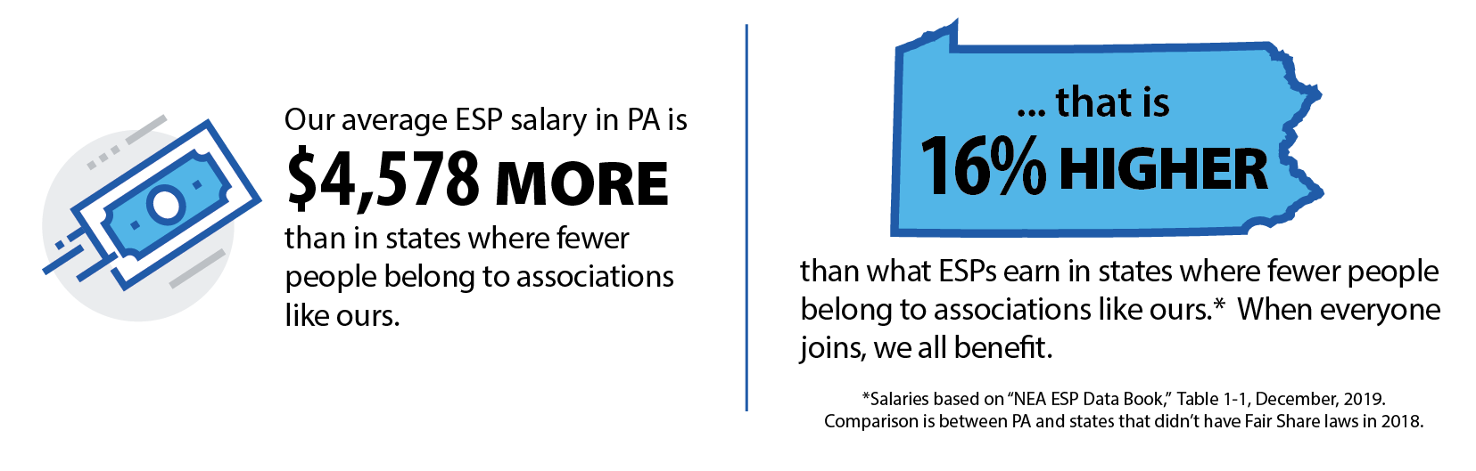
Our Livelihoods: Financial Stability
The wages for PA ESPs are 16 percent higher on average when compared to other states.
Act 13: PSEA members accomplished financial security for all ESPs through successfully advocating for ACT 13 to pass in March 2020
Guaranteed school budgets, protected jobs, and ensured pay through June 30
Lobbied for PSSAs and Keystone Exams to be canceled
Notes:
Cue graphics/content from belong flyer with 18 % (use percentages and not dollar figures)
ACT 13: our members advocated for guaranteed school budgets and protected jobs - all education support professionals got paid through June – stability was fought for and won

Slide 8
PSEA’s Professional Growth Opportunities
Speaking from Experience [Speaker will share personal example of involvement with a statewide or regional training or function]
Guidance on how to keep you safe while on the job during COVID-19
Network and share ideas with peer ESPs from across the state, and in neighboring districts
Professional Development and Educational Services at your fingertips
Local Opportunities [any scheduled trainings/speakers coming up for the 2020-21 year]
Notes:
Professional Growth Opportunities- Presenter will use this time to talk about the added network of support for new members- talk about personal experiences he or she may have been involved - with in local, region, and state
Networking
Professional Development and Educational Services – Ch. 14 programs for paras for example
Local Opportunities

Slide 9
Union Protections
Weingarten Rights and Legal Protections
"If this discussion could lead to my being disciplined or terminated, I respectfully
request that my association representative be included in the meeting. Without
representation, I choose not to answer any questions.”
If an advocate is not available, an employee can ask that the meeting be postponed.
Notes:
Weingarten Rights overview (Image of Weingarten Card would be great on this slide)

Slide 10
Collective Bargaining Agreement: Your Contract
Terms & Conditions of Employment
Grievance Procedure
[custom highlight by local]
Notes:
CBA – if possible, presenter can have their original contract (likely from sometime in the 1970s) to compare some of the language, wages. Show how far they’ve come (maybe look at negotiated starting hourly wage rate from the original contract to what it is today?) bc of work of union members before them.
Pages in the document today
Presenter can select a section of their contract to highlight

Slide 11
Benefits of Membership
Free College Tuition program for associate’s degree
PSEA offers peace of mind: You focus on your job, and the team supporting you will focus on protecting your rights as an ESP and a union member.
Liability Insurance
Discounts
Notes:
Benefits of Membership
ESP focused – free college for associates degree
You can focus on your job, peace of mind
Insert liability insurance and legal protection offered by member benefits

Slide 12
Social Justice and Advocacy
PSEA members are committed to ensuring that ALL students have what they need to succeed, and ALL Education Support Professionals have what they need to do their jobs safely and effectively.
We have your back.
Fighting against subcontracting
Keeping our communities safe
Keeping our jobs local
Notes:
ESP – We have your back in fighting against subcontracting, keeping our communities safe, and keeping your jobs local

Slide 13
Sounds great! Sign me up.
Signing the enrollment form is just the start.
How to get involved in the local
How to keep up with PSEA news and events
How to access your member benefits
How to join us and be heard
Notes:
Stay informed
Social media platforms – local, division, state
Local activities – meetings, community events, trainings
Member Benefits: My Deals App, PSEA website, NEA website

Slide 14
Questions?
Notes:
We know that there is a lot on your mind. This is quite a bit to digest in addition to beginning your 2020-2021 school year.
What is on your mind? Thoughts? Questions? Concerns?
If there are no questions, presenter will emphasize that PSEA and the local association is always here for them. There is so such things as stupid question.
Please reach out whenever you need to!

