Slide 1
PSEA: The Voice for Teachers, Students and Public Education in PA
JOIN US and be heard.
Notes:
Brief general intro slide, insert Comms awesome branding/tag line!
EA-focused (reference teachers and other educator positions – guidance counselors, speech therapists, school psychologists, school nurses, etc…)

Slide 2
[INSERT LOCAL] Education Association
Welcome! I am the XXEA [President, Officer, Membership Chair, etc…]
About Me
Why I joined the Association and why I’ve stuck with it.
Notes:
Introduction Slide for Presenter – Presenter shares story of why he or she became a member of PSEA and got involved – story of self (Why did you join? Why have you remained an active member of the association?)

Slide 3
PSEA PROMISE:
We are here for you. We are you.
Student teaching stress level during a global pandemic with school closures.
Student teaching experience cut short
Navigating new CDC guidelines
Changing expectations for classroom set up
Unchartered waters in education
Student teaching stress level
In a normal year.
Notes:
Some kind of visual to represent we acknowledge the stress level has been / is OFF THE CHARTS! For new teachers who finished their student teaching year early / abruptly.
EA message – we realize the stress you are dealing with as a new educator…unconventional ending (student teaching cut short, new CDC guidelines and having to implement them, it’s unchartered waters that we have entered, but we have entered them together, as a union, as a family…we are here for you)
Some new hires may be coming from the Long term sub ranks but Act 13 covered them as well.

Slide 4
Together
We fight for the salaries and benefits we need to support our families.
We protect members when you need it most so we have the peace of mind to do our jobs.

Slide 5
We Have Your Back.
In times of crisis, PSEA members pull together and are there for each other. Just as we have been a guiding voice navigating COVID-19 closures, PSEA leads the efforts to protect public education in PA. Together.

Slide 6
Collective Power: The PSEA Difference
Strong History of member-led Collective Action
On March 4, 1968, a group of 20,000+ PSEA members and supporters organized to rally on the steps of the capital to demand fair wages and better working conditions.
While it did not happen overnight, the Legislature passed Act 195 of 1970 winning collective bargaining rights for school employees.
Notes:
Before group texting was a thing!
Insert significant historical wins - IF POSSIBLE – have the local reference their original contract, and state what the wages were at that time. Most likely this would be from the early-mid 1970s…… how far we’ve come.

Slide 7
Collective Structure: The PSEA Difference
XXEA: Our Local Association – representing each member is at the center of everything we do.
[INSERT REGION] (location of region office)
PA State Education Association (Harrisburg)
National Education Association (Washington, D.C.)
Notes:
Hit the point of Local association > Region > Statewide PSEA > NEA (downplay)

Slide 8
Your Local Education Association
The Association IS the members!
Procedural Justice
One Member One Vote
Run by and for the members
Notes:
-Mention the local governance, emphasize that these are rank and file members leading the efforts but relying on all members to get involved and share their expertise, their opinions, their energy.
Define Procedural Justice for them
refers to the fairness of the procedures used to make decisions. Listening to members and providing them with input into decisions are key components of procedural justice.

Slide 9
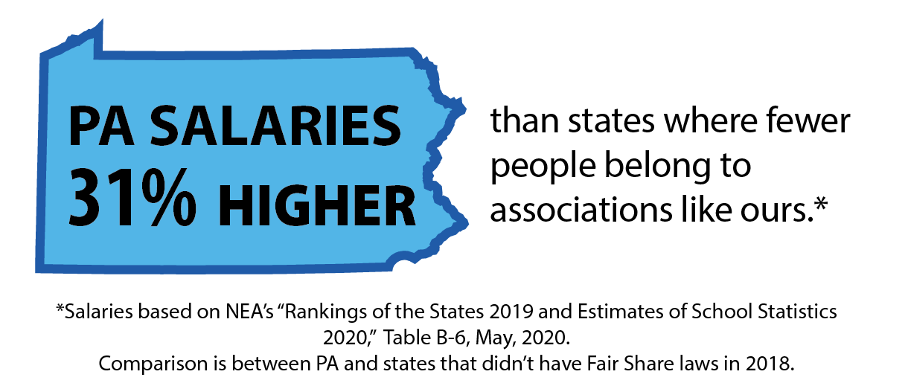
Our Livelihoods: Financial Stability
Wages for PA Educators are 31% higher on average compared to other states where fewer people belong
to associations like ours..
Act 13: PSEA members maintained financial stability through the COVID crisis by winning passage of ACT 13 in March 2020
Lobbied for student teachers to qualify for state certification despite being prevented from finishing the 12-week student teacher requirement
Lobbied for PSSAs and Keystone Exams to be canceled
Notes:
Cue graphics/content from belong flyer with 31 % (use percentages and not dollar figures)
Highlight that PSEA members successfully fought to ensure every EA member was paid for the full school year and that their pensions were protected.

Slide 10
PSEA’s Professional Growth Opportunities
Speaking from Experience [Speaker will share personal example of involvement with a statewide or regional training]
Network and share ideas with peer educators from across the state, and in neighboring districts
Professional Development and Educational Services at your fingertips
Local Opportunities [any scheduled trainings/speakers coming up for the 2020-2021 year]
Notes:
Professional Growth Opportunities- Presenter will use this time to talk about the added network of support for new members- talk about personal experiences he or she may have been involved - with in local, region, and state
Networking
Professional Development and Educational Services – IEP Toolbox for example
Local Opportunities

Slide 11
Union Protections
Weingarten Rights and Legal Protections
"If this discussion could lead to my being disciplined or terminated, I respectfully
request that my association representative be included in the meeting. Without
representation, I choose not to answer any questions.”
If an advocate is not available, an employee can ask that the meeting be postponed.
Notes:
Weingarten Rights overview (Image of Weingarten Card would be great on this slide)
DISTRIBUTE WEINGARTEN CARDS

Slide 12
Collective Bargaining Agreement: Your Contract
Terms & Conditions of Employment
Grievance Procedure
[custom highlight by local]
Notes:
CBA – if possible, presenter can have their original contract (likely from sometime in the 1970s or use One page Wisconsin contract) to compare some of the language, wages. Show how far they’ve come (maybe look at negotiated starting hourly wage rate from the original contract to what it is today?) bc of work of union members before them.
Pages in the document today
Presenter can select a section of their contract to highlight

Slide 13
Benefits of Membership
PSEA offers peace of mind:
You can focus on your job confident in the knowledge that your association is protecting your rights as a union member, advocating for your profession, and providing career development.
Liability Insurance
Discounts
Notes:
Benefits of Membership
You can focus on your job, peace of mind
Insert liability insurance and legal protection offered by member benefits

Slide 14
Social Justice and Advocacy
PSEA members are committed to ensuring that ALL students have what they need to succeed.
Our members remain focused on their students:
Academic experience
Social and emotional well-being
Love for learning
To achieve this, our members must have the resources they need. And that is at the center of our advocacy efforts.
Notes:
EA -- Ensuring students have what they need to succeed – we ensure their academic learning, but also ensure their social and emotional well-being – keeping students motivated and instilling the love for learning

Slide 15
Sounds great! Sign me up.
Signing the enrollment form is just the start.
How to get involved in the local
How to keep up with PSEA news and events
How to access your member benefits
How to join us and be heard
Notes:
Stay informed
Local activities – meetings, community events, trainings
Emphasize following local / region / state Facebook page for up to date information
Member Benefits: My Deals App, PSEA website, NEA website

Slide 16
Questions?
Notes:
We know that there is a lot on your mind. This is quite a bit to digest in addition to beginning your 2020-2021 school year.
What is on your mind? Thoughts? Questions? Concerns?
If there are no questions, presenter will emphasize that PSEA and the local association is always here for them. There is so such things as stupid question…especially if this is your first year of teaching! Please reach out whenever you need to!

