Slide 1

Digital Campaigning
Will Robinson

Slide 2
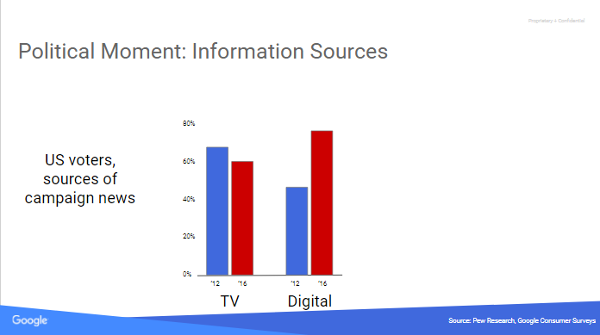
INFORMATION SOURCES

Slide 3
TV VIEWERSHIP

Slide 4
65% LIGHT TV VIEWERS

Slide 5
4 in 10 Voters

Slide 6
People 18-34 and People 35-49 have about the same share of media usage going to digital.

Slide 7
Republicans had a strong three prong strategy that was the campaign side, the IE side, and the Publisher side.

Slide 8
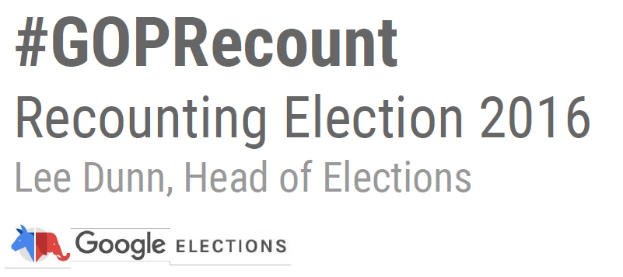
GOP RETREAT DOCUMENT
Notes:
Ward Baker
Google doc

Slide 9
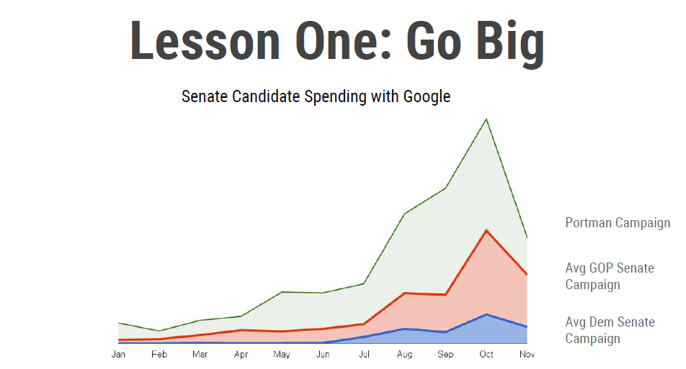
Notes:
40% of budget
Early and late

Slide 10
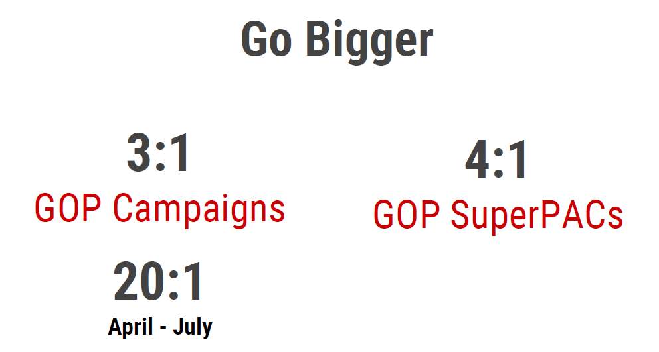
Notes:
40%
Trump 1.2:1

Slide 11
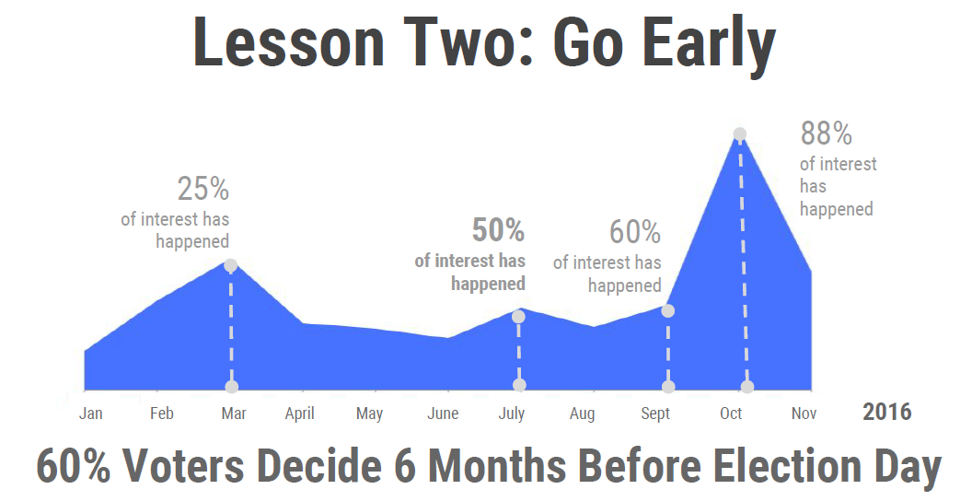
More Digital Early and Late

Slide 12
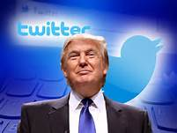
Trump Digital
On any given day, Coby says, the Trump Campaign was running 40,000 to 50,000 variants of its ads, testing how they performed in different formats, with subtitles and without, and static versus video, among other small differences. On the day of the third presidential debate in October, the team ran 175,000 variations. Coby calls this approach “A/B testing on steroids.” The more variations the team was able to produce, Coby says, the higher the likelihood that its ads would actually be served to Facebook users.
Notes:
Clinton outspent Trump on TV
Clinton's campaign placed a far greater emphasis than Trump on television advertising, a more traditional way of reaching swaths of voters. She spent $72 million on TV ads and about $16 million on internet ads in the final weeks.
The Trump campaign spent nearly $39 million on last-minute TV ads and another $29 million on digital advertising
Trump no TV from nomination to convention
Twitter for Trum
Facebook for $

Slide 13
Trump For President 2016
They claimed to have “three major voter suppression operations under way” at the end of the campaign aimed at idealistic white liberals, young women, and African Americans.It’s impossible to measure how effective this was since most of the efforts were via Facebook “dark posts” — nonpublic paid posts shown only to the Facebook users that Trump chose.
And finally, the other thing to keep in mind for 2018 is Trump’s not-so-secret database, which is called Project Alamo and supposed contains information on 220 million people in the United States, and approximately 4,000 to 5,000 individual data points about the online and offline life of each person.

Slide 14
Focused GOP Digital Targeting
The Trump campaign and Republican Party spent heavily in Michigan, Wisconsin, Pennsylvania and Florida. About $5 million in get-out-the-vote digital advertising targeted in the final few days. AP 12/09/16
Notes:
https://medium.com/soapbox-dc/what-companies-candidates-and-yes-even-government-institutions-can-learn-from-2016-363e75004192#.pnlukstnh

Slide 15

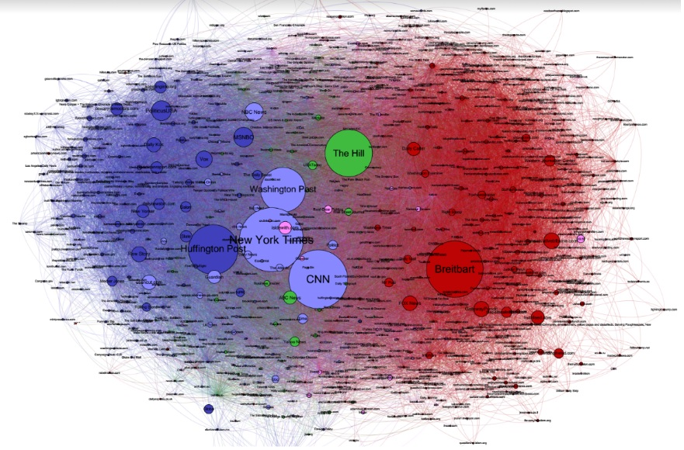
Breitbart developed a distinct and insulated media system
Media sources shared on Twitter during the election (nodes sized in proportion to Twitter shares). #1 source trump retweeters Media Cloud, Harvard’s Berkman Klein Center for Internet & Society and MIT’s Center for Civic Media.

Slide 16
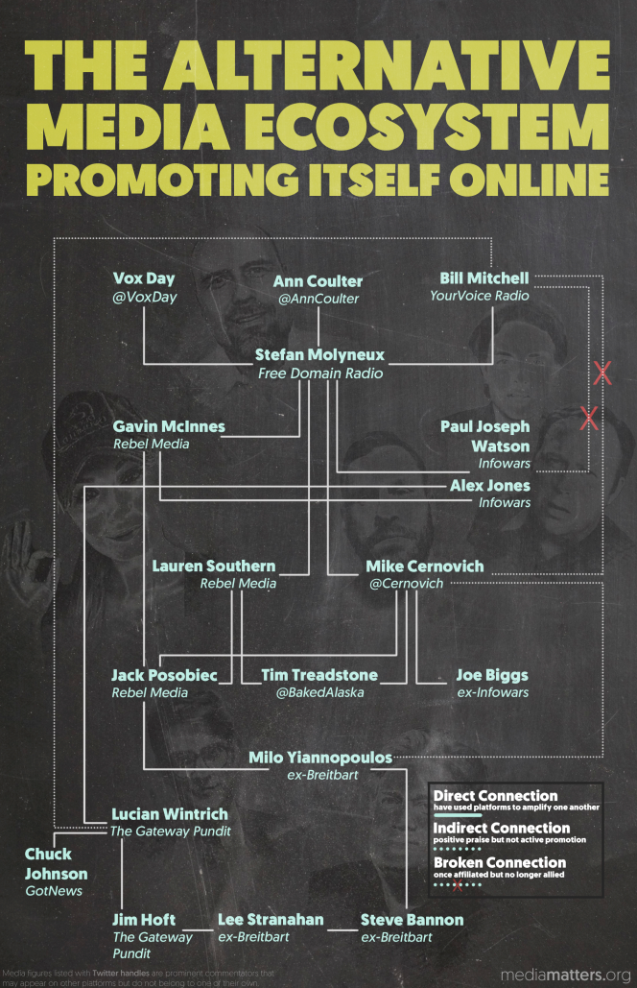
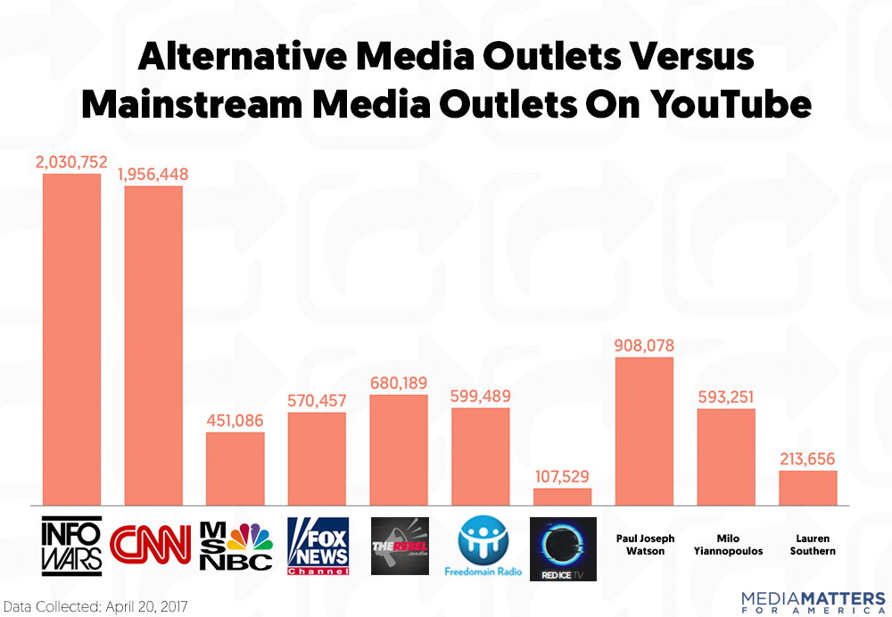
Fake News Continues
Notes:
According to a Pew Research Center survey conducted in early 2016, about half of people age 49 and under said they get their news online. And as cable news viewership declines and as Americans’ trust in news media sinks to an all-time low, Media Matters

Slide 17
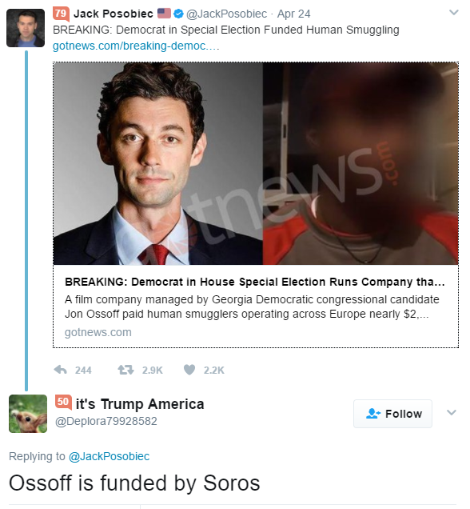
Tying Ossoff to Human Smuggling
Right-wing news site GotNews.com publishes story about Ossoff’s film company paying human smugglers in Europe
  100 tweets by 92 people share story reaching 317,779 people
  Shared on Reddit in AskThe_Donald sub-reddit (31 comments)
RebelTV’s Washington correspondent shares story and another tweeter asserts Soros connection.

Slide 18
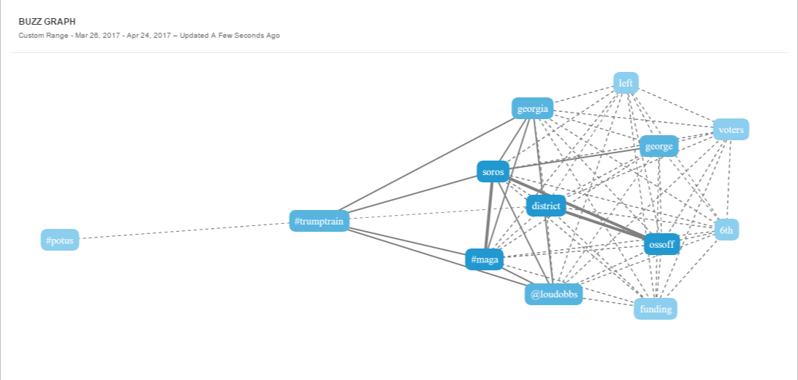
Twitter responds to blogs, generating 8,023 tweets
#Trumptrain picks it up
@LouDobbs is a key source
  Says Soros, not GA-6 voters, funding Ossoff
  2.8K RTs, 4.1K Likes, 306 replies
  3,178 tweets mentioning Ossoff, Dobbs & Soros

Slide 19
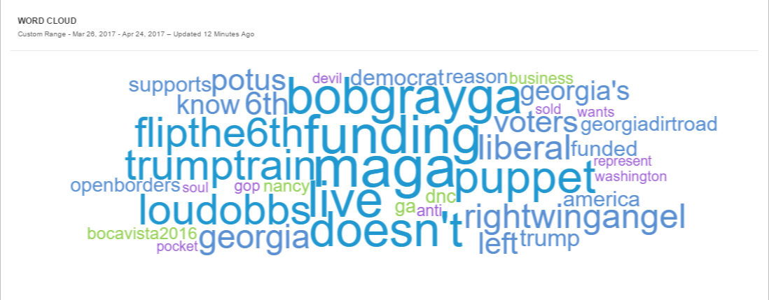
What are people saying about Ossoff’s connections to Soros, Pelosi & Al Jazeera?
When talking about connections between Ossoff and Pelosi/Soros/Al Jazeera, people say Ossoff
  Is a puppet (14.6%)
  Is funded by Soros (8.20)
  Supports open borders (7.6%)
  Is in their pocket (6.1%)
  Doesn’t live in the district (6.0%)
  Sold his soul to the devil (6.2%, 911 tweets)
Key hashtags
  #MAGA (24.1%)
  #TrumpTrain (13.6%)
  #FlipThe6th (13.3%)
Key Influencers
  @LouDobbs
  @RightWingAngel
  @GeorgiaDirtRoad

Slide 20

Russian Attacks
The digital era has afforded the Kremlin and other state and non-state actors new tools in such efforts, from phishing attacks against campaign staffers to fake news distributed through social media. These attacks continue…
Trump had a significantly higher number of bot supporters, with Georgia leading all states in total amount of bot-generated political tweets. New York, Mississippi and Florida also showed above average political bot activity. USC Viterbi School of Engineering’s Information Sciences Institute.

Slide 21
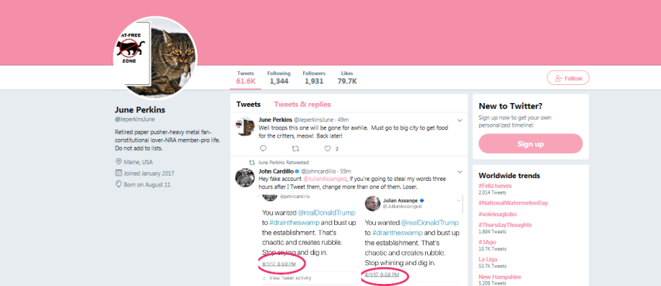
Meet “June Perkins”

Slide 22
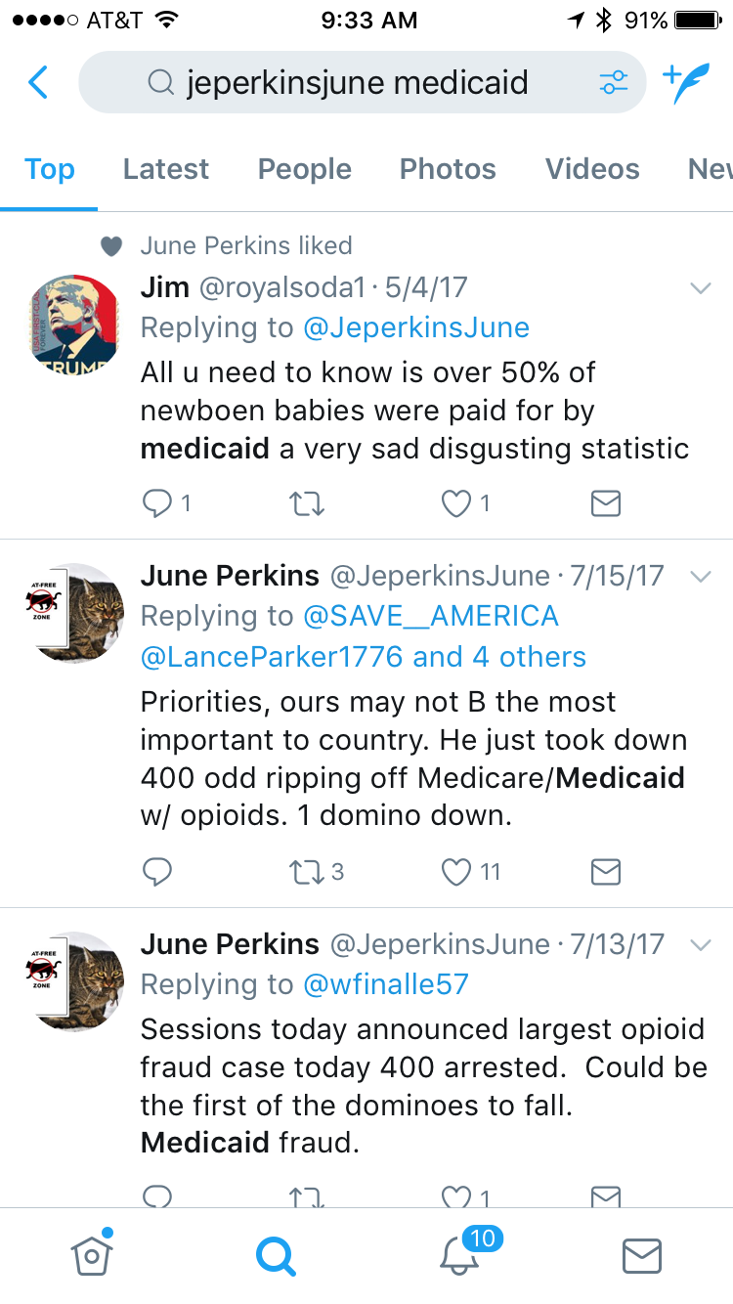
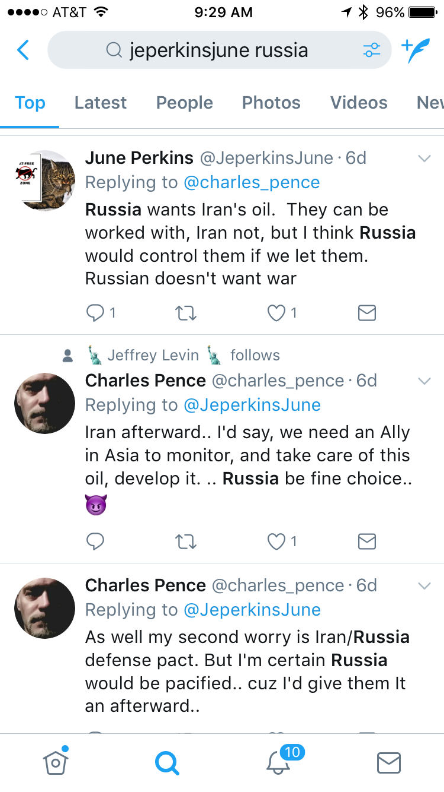
Bot Content

Slide 23




50.47% match rate on FB : 64,500 of 127,797 total list size. 80% matched at least once through the DS Political cookie pool.
Served 17 videos and 7 static ads on Facebook. 7 statics and 13 videos ads served on DSP – over a month
1,249,639 impressions, 196,158 video views on Facebook 1,996,831 views on DS political
38 cents a completed video view (DSP) 22 cents (FB)
74.47% completion rate across all universes
4573 “Points” of TV
Notes:
Will Robinson Slide

Slide 24
Program and Context
Program: Pre-roll video. Half treatment, half pure control. Matched treatment group to DSP’s cookie pool, which is made up of 5 match partners (80% matched at least once).
Ads ran: 3/29-4/26
Context: Contested presidential primary; noisy environment.
Clinton on national scene since 1992
Still some room for persuasion
  Initial vote choice: 51% Clinton, 11% Undecided
  Initial Clinton Fav: 71% Fav, 2% Unsure
Notes:
Will Robinson Slide

Slide 25
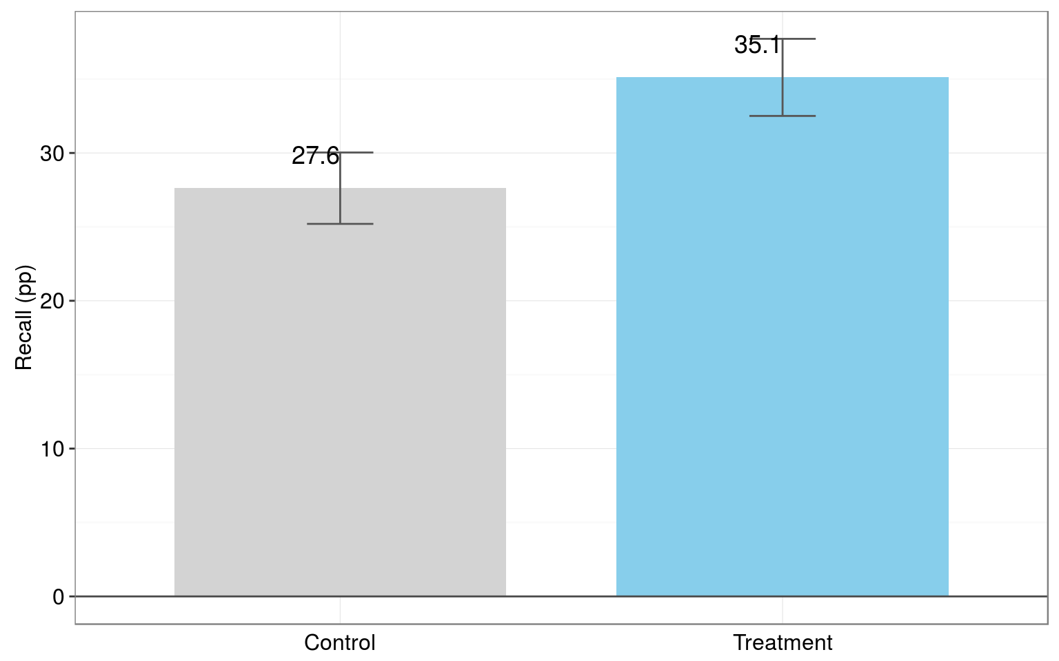
Voters in the Treatment Group Had a High Recall Rate for Receiving the Digital Program
“In the past month, have you seen any videos on a computer, smart phone, or other mobile device talking about Hillary Clinton’s record on education?”
Highest digital recall effect we’ve ever seen!
+ 7.5 pp
Turnout (%)
p = 0.001
n = 2,459
Control

Slide 26
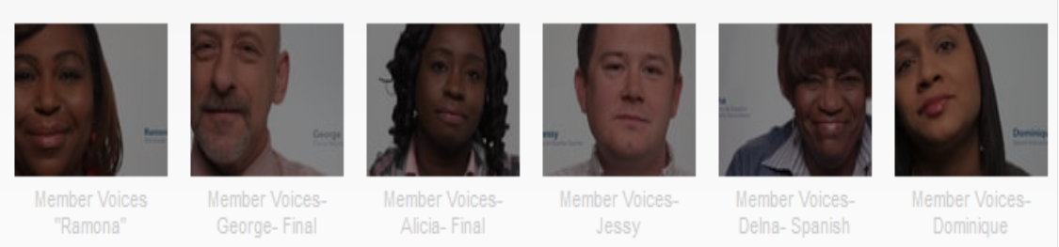
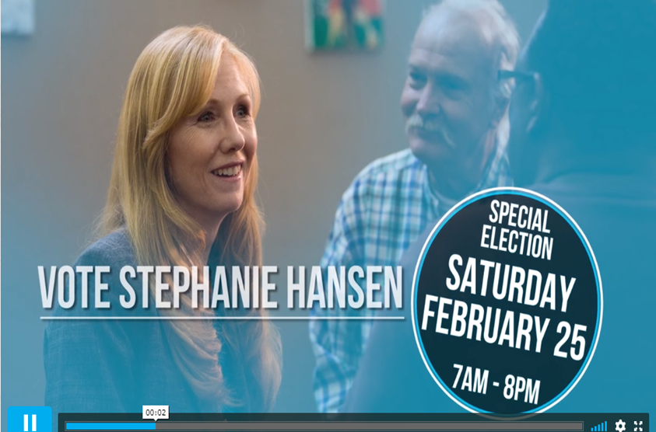
Social Media Ads
What social video has going for it is the social validation component that comes from people engaging with your ads (i.e., when someone likes/comments/shares, it also shows up in their friends’ feeds.
The average Facebook view is 6 seconds, but you’ve got the opposite dynamic with FB static vs web static ads – they are engaged with more on FB.

Slide 27
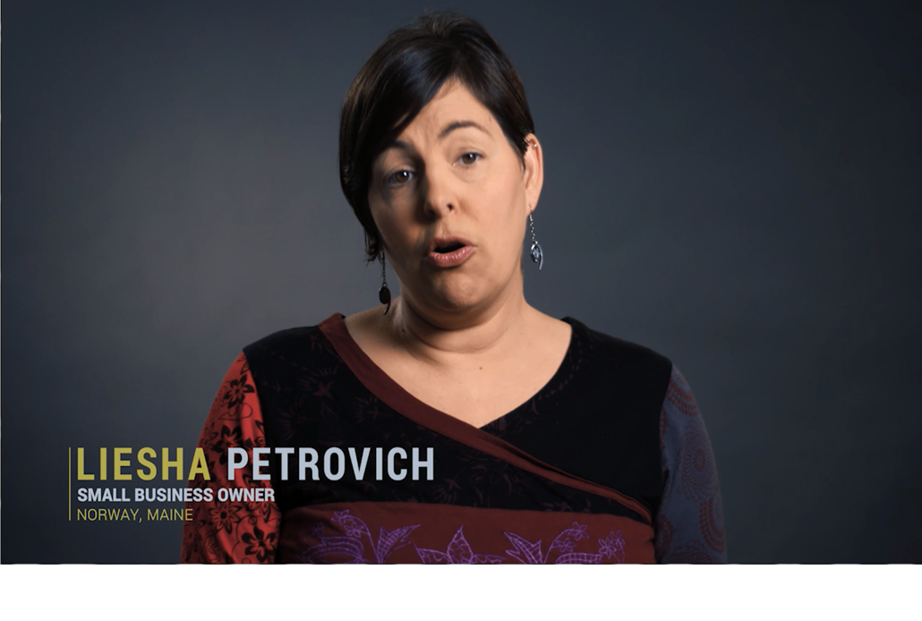
Pre Roll Ads
Pre-roll tends to be more expensive, but when you want to make sure people are actually seeing your whole ad (i.e. for persuasion/education), it’s the way to go: you’ll likely see completion rates of between 55-70%, vs. 2-5% VCR on Facebook. Even when FB videos are shorter, you’re probably still rarely going to see VCRs of higher than about 20% or so.

Slide 28
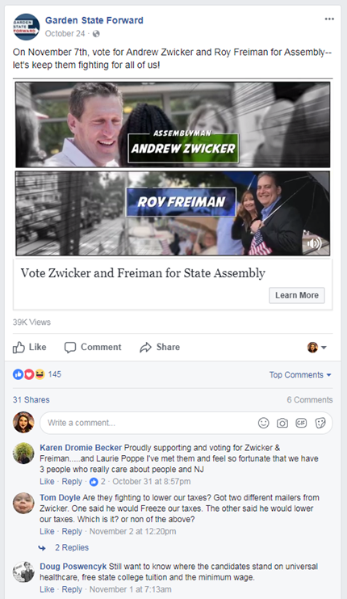
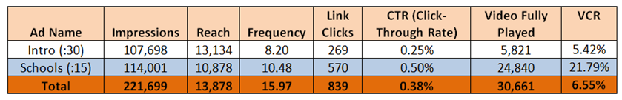
Evaluating Digital
Social Media Metrics

Slide 29
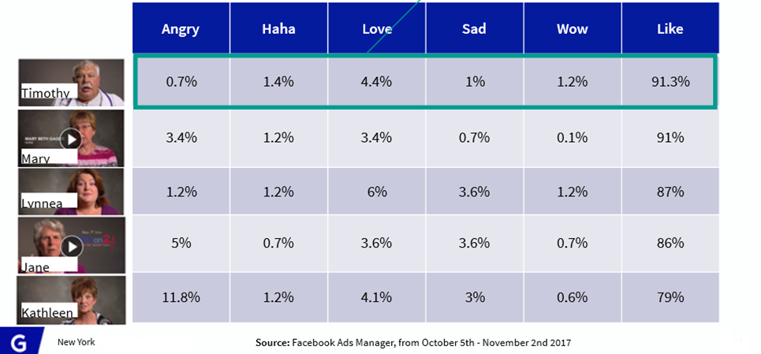
Creative Performance
Tim delivers the highest % of likes, driven by his credible persona and strong language

Slide 30
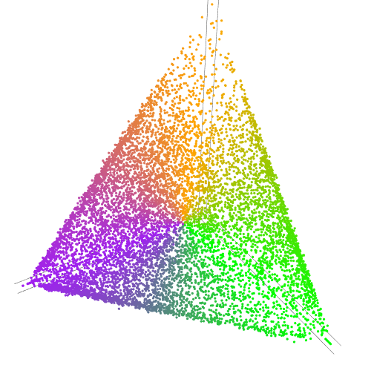
Authoritarian
A spectrum of political orientations
Collectivist
Individualist
Notes:
So let’s dispense with the line and think of this more like a cycle of orientations.

Slide 31
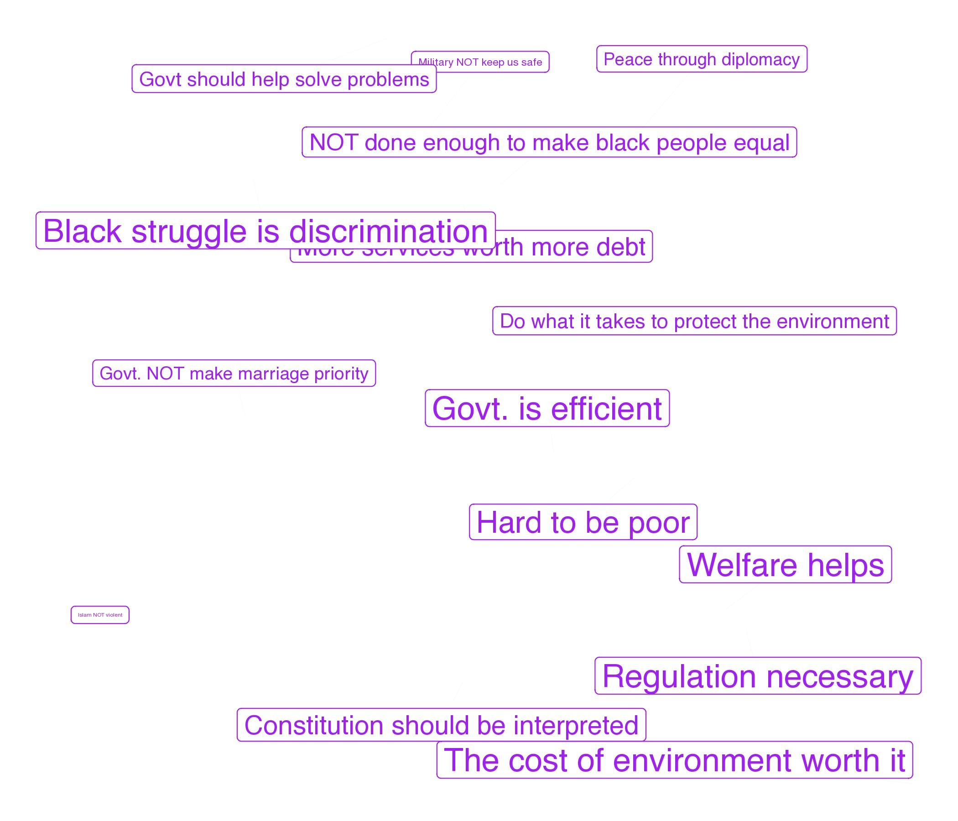

The COLLECTIVIST Perspective
COLLECTIVIST
Social justice
Economic equality
Regulation
Notes:
Because of the type of clustering we used, people are not pushed apart here. Instead, there are these three corners that represent extreme viewpoints, and everyone is somewhere inside the space.
It is less true to think of the purple people as Collectivists than as people who tend to see things from this perspective.

Slide 32
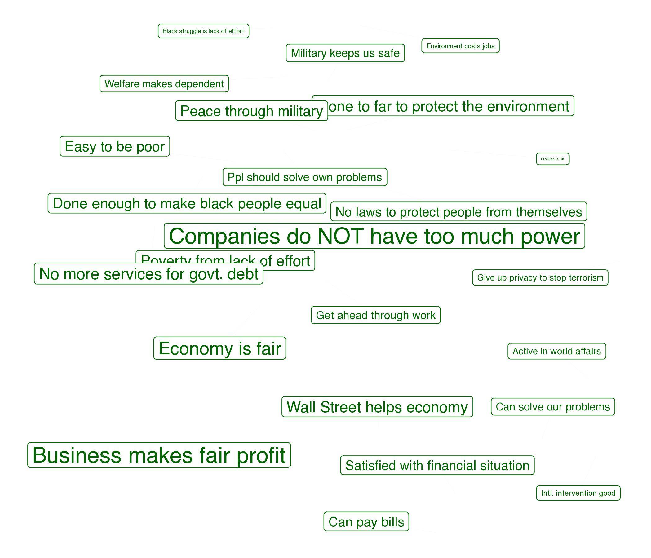
The INDIVIDUALIST Perspective
INDIVIDUALIST
Free industry
Individual effort
Minimal regulation

Slide 33
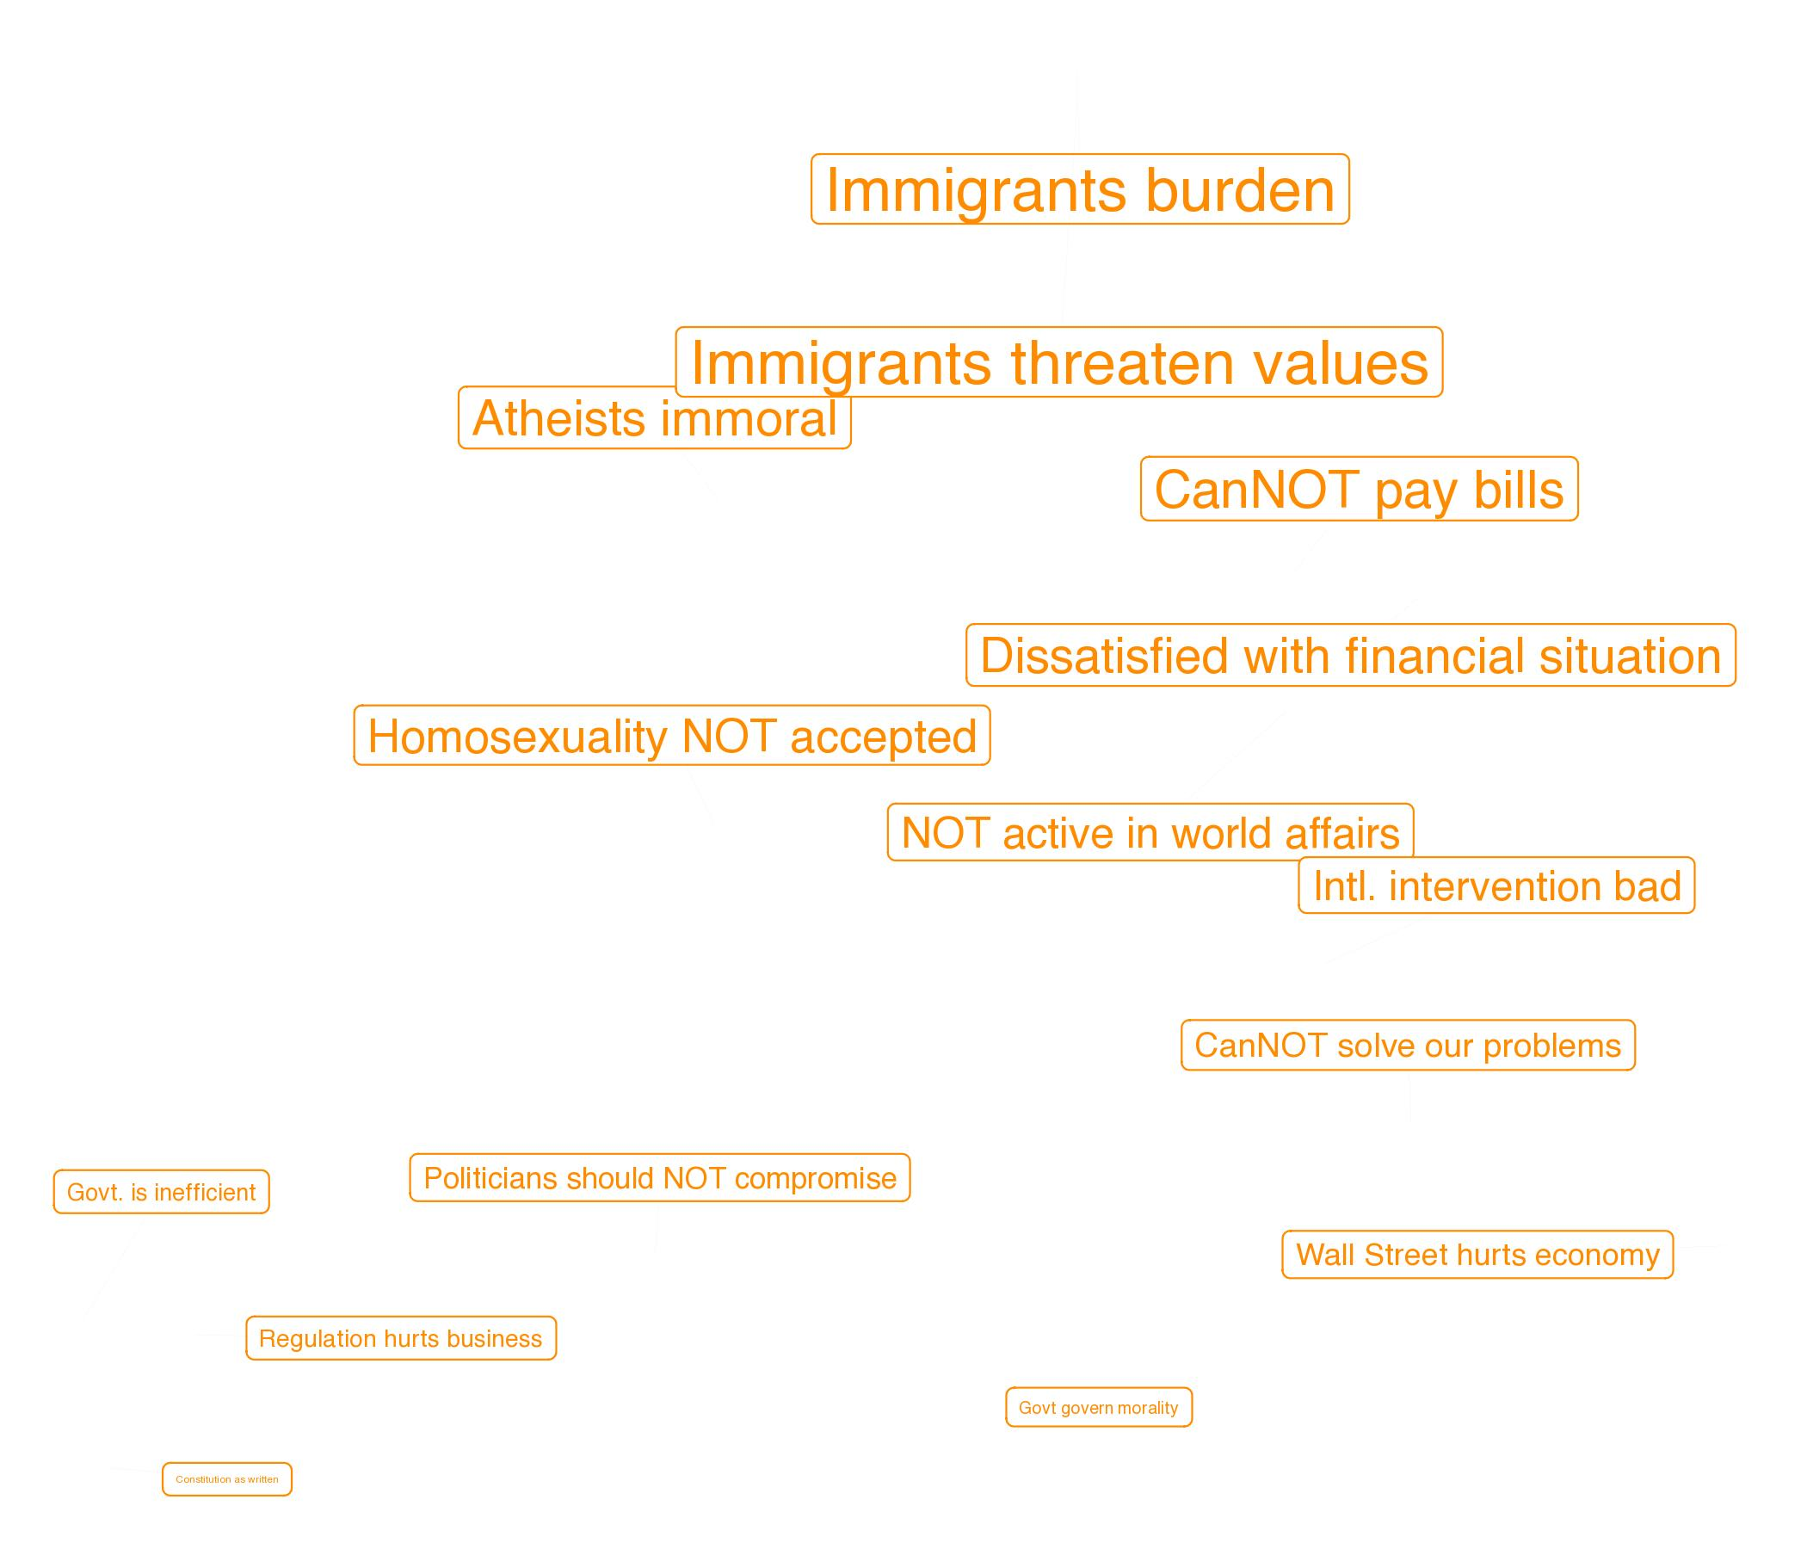
The AUTHORITARIAN Perspective
SOCIAL ORDER / AUTHORITARIAN
Group identity
Social hierarchy
Isolationism
Notes:
I wish I had another word to describe this group.

Slide 34
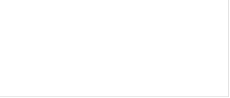
A note on authoritarianism
Related to Social Order/Dominance Orientation, a worldview that emphasizes protecting existing social hierarchies.
  Believing in God is important
  Hierarchy is fundamental
    “It is necessary to believe in God in order to be moral and have good values”
  Defined by in-groups and out-groups
  Moral Order / Justice
Notes:
Again, I wish I had a better word for this group, especially since this is not characterized by pure authoritarianism (Which is quite punitive). Instead, it looks more like what psychologists call Social Dominance Orientation.
These two things are related, but SDO is about believing in a hierarchical natural order—that it is right and good that some people be in charge and others subservient.
What I think is really interesting is how important believing in God is to this group. They don’t simply want to hate outgroups—they want the world to be ordered with God at the top.

Slide 35



thenewmediafirm

